Slide 1
DBMS Basic Concepts

Slide 2
DBMS
Database Management System
Term Database requires understanding of
data and information
Data: It can be anything like name, place or number, etc. Data usually refers to raw data, or unprocessed data.
Information: It is organized or classified data so that it has some meaningful values to the receiver.
Information is the processed data on which decisions and actions are based.

Slide 3
Difference between Data and Information?

Slide 4
Data | Information
Data is raw facts and figures | Information is a processed form of data
For example: 12 is data | For example: When 12 is stored in row column form as shown it is information. Age 12
Data are atomic level pieces of information | Information is a collection of data
Data does not help in decision making | Information helps in decision making

Slide 5
Database
A database is a shared collection of logically related data designed to meet the information needs of an organization
The related information when placed is an organized form makes a database.
The organization of data/information is necessary because unorganized information has no meaning.

Slide 6
Purpose of DBMS
An example
University Database:
Data about students, faculty, courses, research-laboratories, course registration/enrollment etc. Reflects the state of affairs of the academic aspects of the university.
Purpose: To keep an accurate track of the academic activities of the university.

Slide 7
Purpose of DBMS
Before DBMSs were introduced, organizations usually stored information in file processing system which has a number of disadvantages:
Data redundancy and inconsistency
Difficulty in accessing data
Data isolation
Integrity problems
Atomicity problems
Concurrent-access anomalies
Security problems

Slide 8
Database Management System
DBMS A database management system is the software system that allows users to define, create and maintain a database and provides controlled access to the data.
A database management system (DBMS) is basically a collection of programs that enables users to store, modify, and extract information from a database as per the requirements.

Slide 9
Operations on databases
To add new information
To view or retrieve the stored information
To modify or edit the existing
To remove or delete the unwanted information
Arranging the information in a desired order etc.

Slide 10
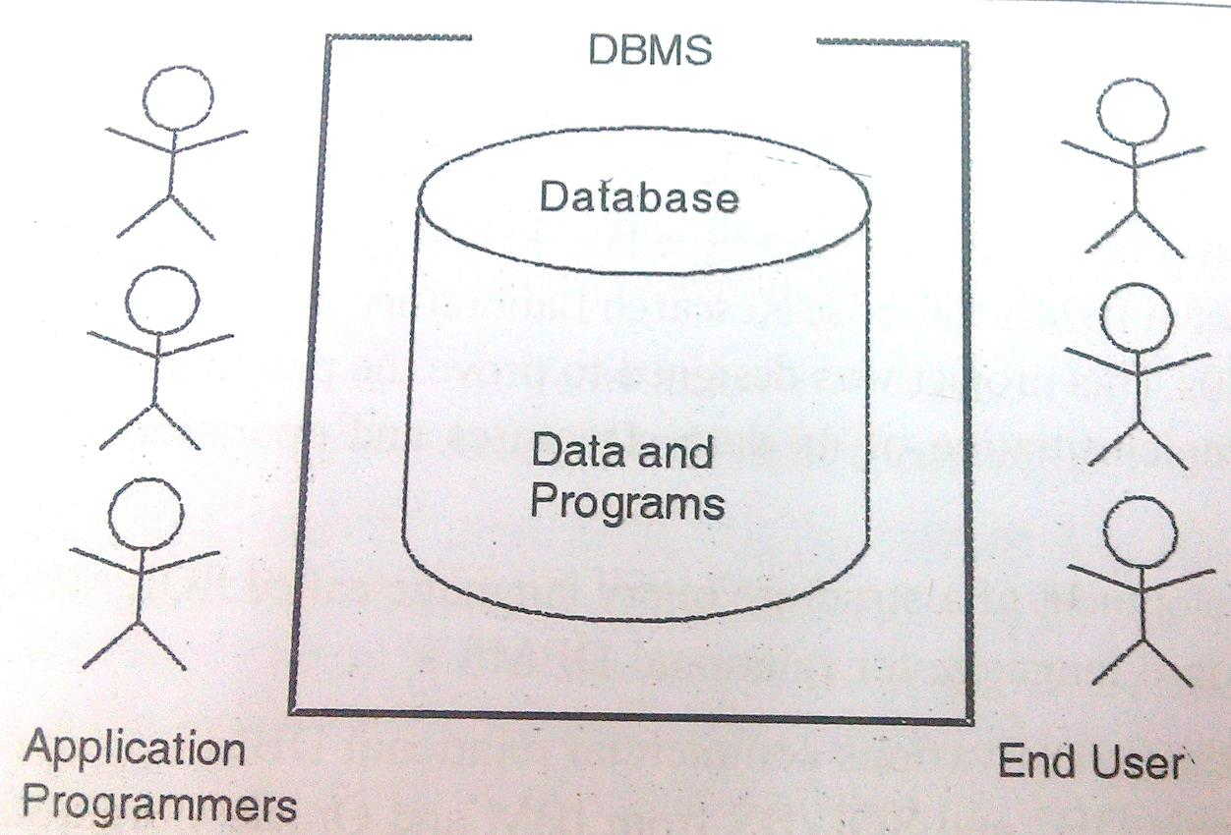
Components of Database
Five major components in database system environment:
Hardware
Software
Data
Users
Procedures

Slide 11
Components of Database System
Hardware: It is the actual computer system used for keeping and accessing the database. DBMS hardware consists of secondary storage devices like hard disks.
Software: It is the actual DBMS. Between the physical database itself and the users of system is a layer of software, called DBMS.
Data: Data acts as the bridge between the machine components and user components.

Slide 12
Components of Database System
Users: There are number of users who can access or retrieve data on demand using the applications and the interfaces provided by DBMS. The users can be:
Naïve users
Online users
Application Programmers
Sophisticated Users
Data base Administrator ( DBA)

Slide 13
Components of Database System
Procedures: It refers to the instructions and rules that govern the design and the use of the database. The users of the system and the staff that manage the database requires documented procedures on how to use or run the system.

Slide 14
Applications of DBMS
Banking: all transactions
Airlines: reservations, schedules
Universities: registration, grades
Sales: customers, products, purchases
Online retailers: order tracking, customized recommendations
Manufacturing: production, inventory, orders, supply chain
Human resources: employee records, salaries, tax deductions

Slide 15
Data models, Schemas, and Instances
Data model:-A set of concepts to describe the structure of a database, and certain constraints that the database should obey.
Schema:- The overall description of the database is called the Database Schema.
A schema is defined as an outline or a plan that describes the records and relationships existing at the particular level.
Instance:- Data in the database at a particular moment in time.

Slide 16
Data abstraction
A major purpose of database system is to provide user with an abstract view of data. That is, system hides certain details of how the data are stored and maintained.

Slide 17
Levels of Abstraction(view of data)
Physical level: describes how a record (e.g., customer) is stored.
Logical level: describes what data stored in database, and the relationships among the data. DBA, who decides what information to keep in the database, use the logical level of abstraction.
View level: describe only part of database. application programs hide details of data types. Complexity remain due to variety of information stored. Views can also hide information (such as an employee’s salary) for security purposes.

Slide 18
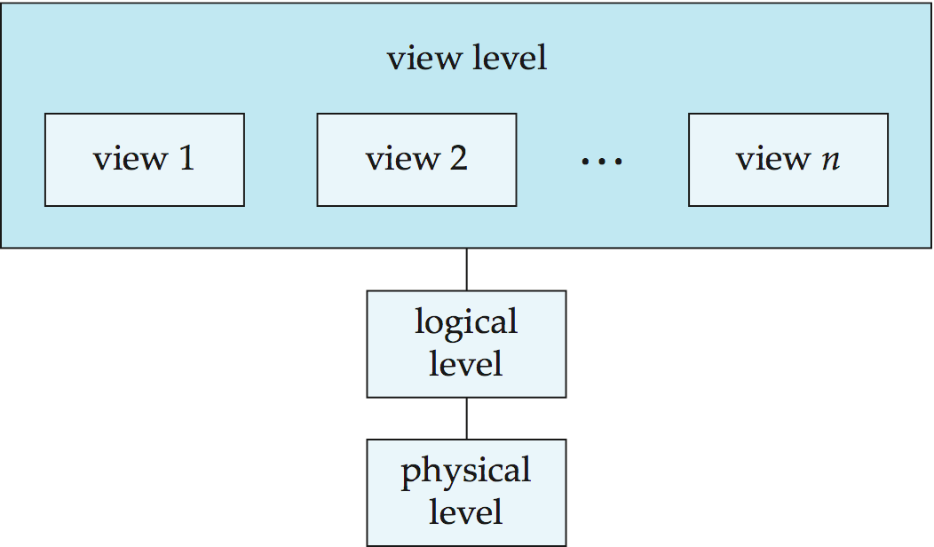
View of Data
An architecture for a database system

Slide 19
Database Languages
Database languages are used to create and maintain database on computer.
Data Definition Language(DDL): It is a language that allows user to define data and their relationship to other types of data.
CREATE
ALTER
DROP
TRUNCATE
RENAME
Data Manipulation Language(DML):It provides a set of operations to support the basic data manipulation operations on the data held in databases. It allows user to insert, update, delete and retrieve data from the database.
DELETE
INSERT
SELECT
UPDATE

Slide 20
Database Languages
Data Control Language(DCL): DCL statements control access to data and the database
GRANT
REVOKE
COMMENT
Transaction Control Language(TCL): TCL statements manage the change made by DML statements, and group DML statements into transactions
COMMIT
ROLLBACK
SAVEPOINT
SET TRANSACTION

Slide 21
Structure and Components of DBMS

Slide 22
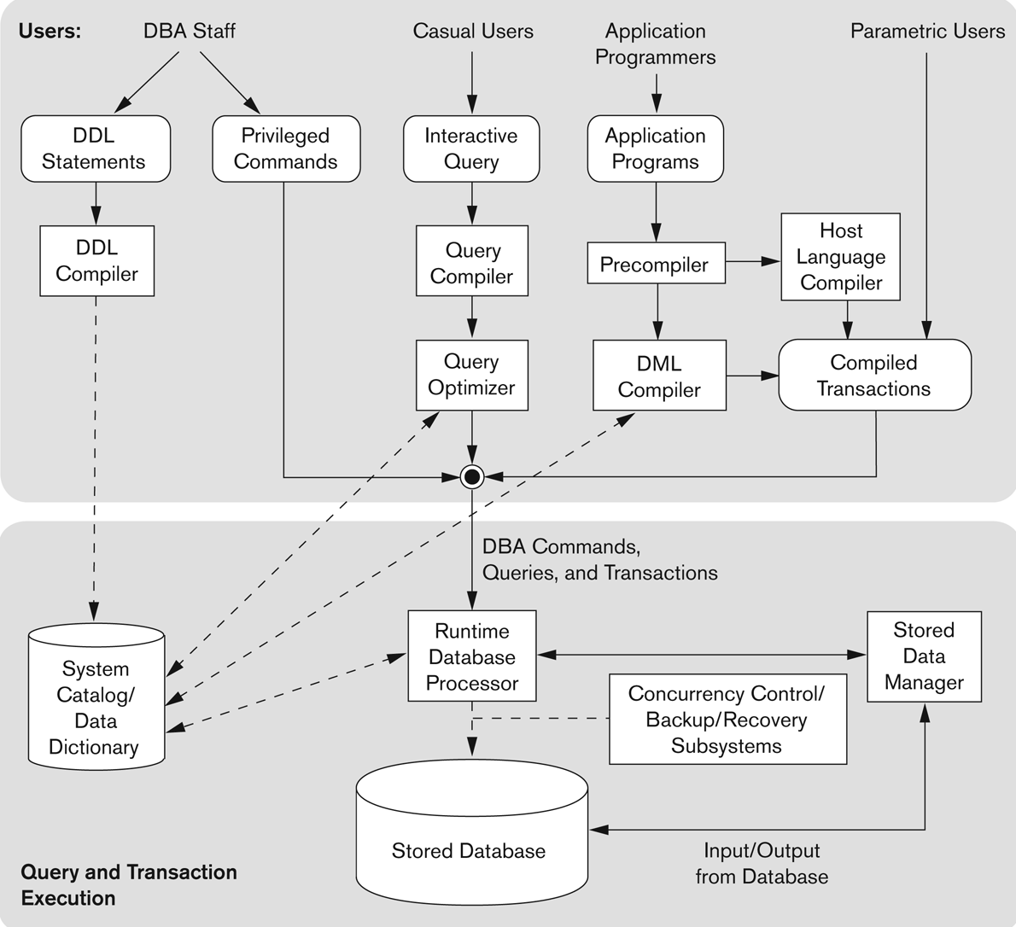

Slide 23
Database Architecture

Slide 24
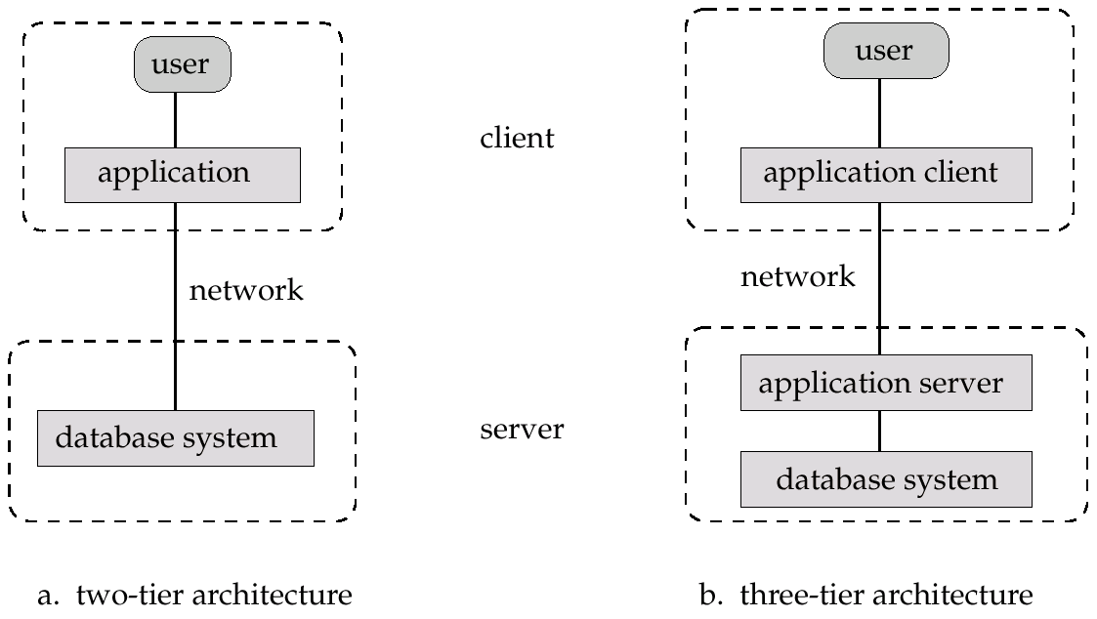
Two-tier and three-tier architecture

Slide 25
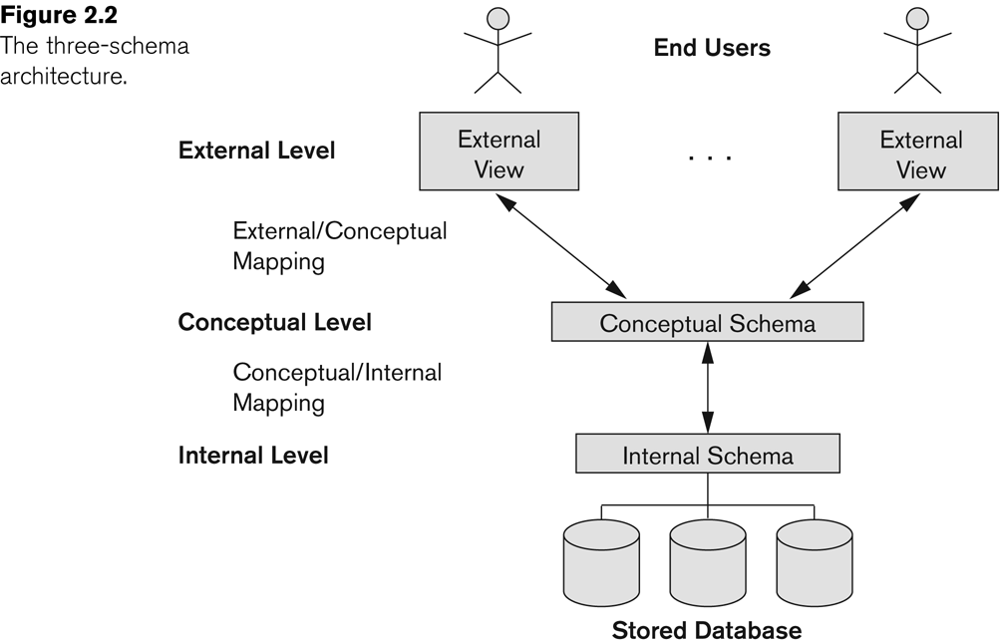
Three-tier architecture

Slide 26
External or View level: It is the users’ view of the database. This level describes that part of the database that is relevant to each user.
For example, one user may view dates in the form (day, month, year), while another may view dates as (year, month, day).
Conceptual or logical level: It is the community view of the database. This level describes what data is stored in the database and the relationships among the data.
It represents:
All entities, their attributes, and their relationships;
The constraints on the data;
Security and integrity information.
Internal or storage level: It is the physical representation of the database on the computer. This level describes how the data is stored in the database.

Slide 27
Data Independence-Achievement of Layered Architecture of DBMS
Two kinds of data independence:
Logical data independence
Physical data independence

Slide 28
Data Independence
Logical Data Independence: The capacity to change the conceptual schema without having to change the external schemas and their application programs.
Physical Data Independence: The capacity to change the internal schema without having to change the conceptual schema.

Slide 29
Data Independence
The processes of transforming requests and results between the levels are called mappings.
When a schema at a lower level is changed, only the mappings between this schema and higher-level schemas need to be changed in a DBMS that fully supports data independence. The higher-level schemas themselves are unchanged. Hence, the application programs need not be changed since they refer to the external schemas.

Slide 30
Data Independence
The processes of transforming requests and results between the levels are called mappings.
When a schema at a lower level is changed, only the mappings between this schema and higher-level schemas need to be changed in a DBMS that fully supports data independence. The higher-level schemas themselves are unchanged. Hence, the application programs need not be changed since they refer to the external schemas.

